Slide 1

Data Management and Exploratory Data Analysis Presentation
Stanly Wilson Palathingal

Slide 2
https://stanlypalathingal.shinyapps.io/EDA_1/
Advancers Explorers Fixers Flourishers Hobbyists Other Preparers Vitalisers
25 36 24 7 12 12 13 45
Advancers Explorers Fixers Flourishers Hobbyists Other Preparers Vitalisers
26 40 25 6 26 18 16 51
Advancers Explorers Fixers Flourishers Hobbyists Other Preparers Vitalisers
46 67 47 14 27 34 25 66
Advancers Explorers Fixers Flourishers Hobbyists Other Preparers Vitalisers
63 58 31 15 28 26 34 64
Advancers Explorers Fixers Flourishers Hobbyists Other Vitalisers
12 7 9 1 3 4 11

Slide 3
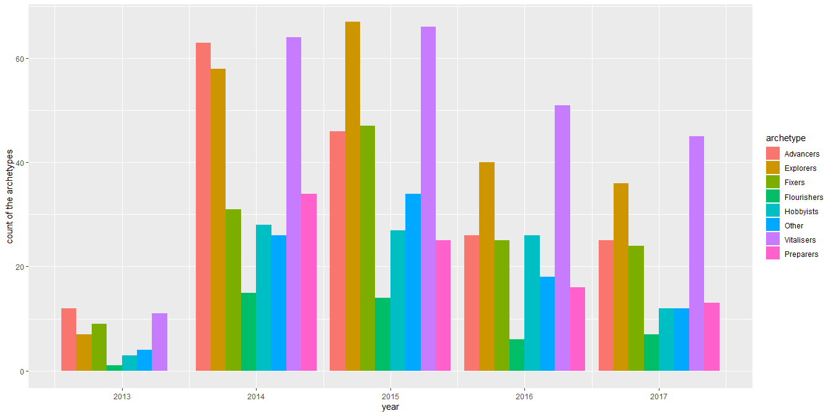

Slide 4
## year enrolled ## 1 2011 14394 ## 2 2012 6488 ## 3 2013 3361 ## 4 2014 3992 ## 5 2015 3544 ## 6 2016 3175 ## 7 2017 2342

Slide 5
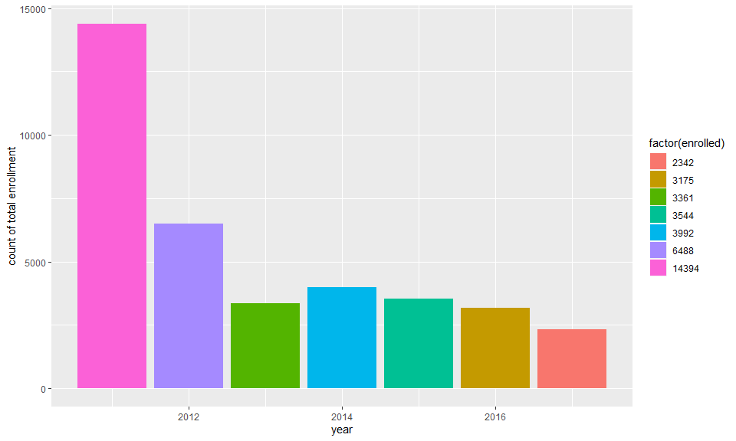

Slide 6
## year week week_n ## 1 2011 week1 3269 ## 2 2011 week2 2022 ## 3 2011 week3 1711 ## 4 2012 week1 1342 ## 5 2012 week2 889 ## 6 2012 week3 668 ## 7 2013 week1 999 ## 8 2013 week2 625 ## 9 2013 week3 448 ## 10 2014 week1 1105 ## 11 2014 week2 706 ## 12 2014 week3 571 ## 13 2015 week1 1088 ## 14 2015 week2 726 ## 15 2015 week3 571 ## 16 2016 week1 667 ## 17 2016 week2 368 ## 18 2016 week3 271 ## 19 2017 week1 603 ## 20 2017 week2 347 ## 21 2017 week3 260

Slide 7
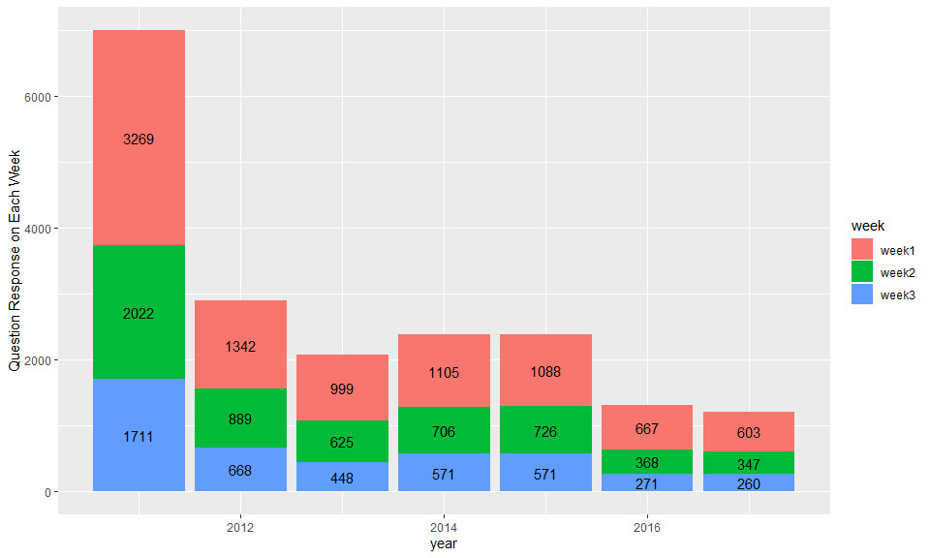

Slide 8
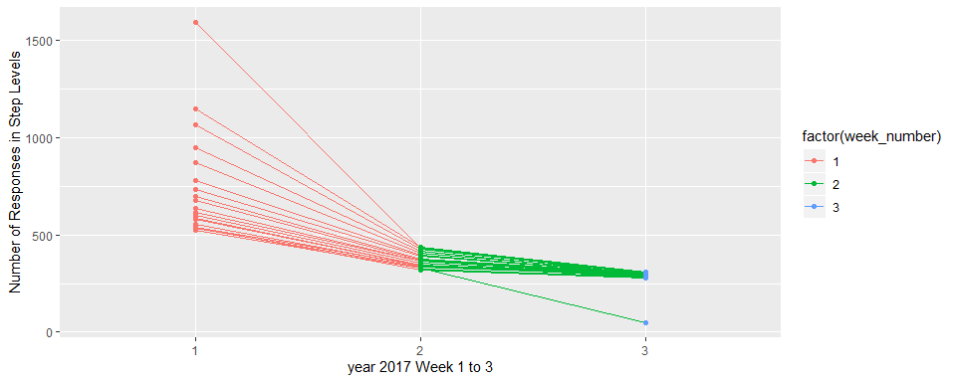

Slide 9
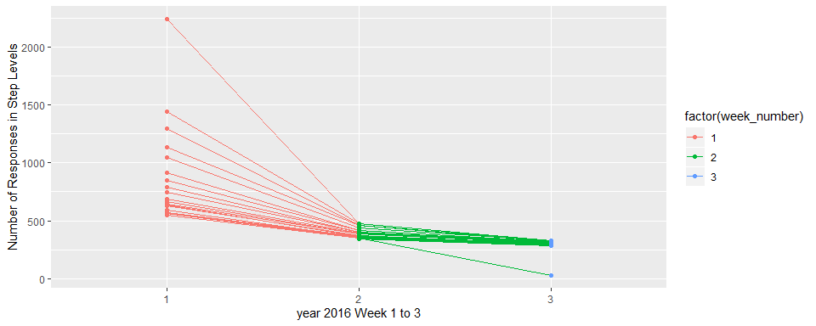

Slide 10
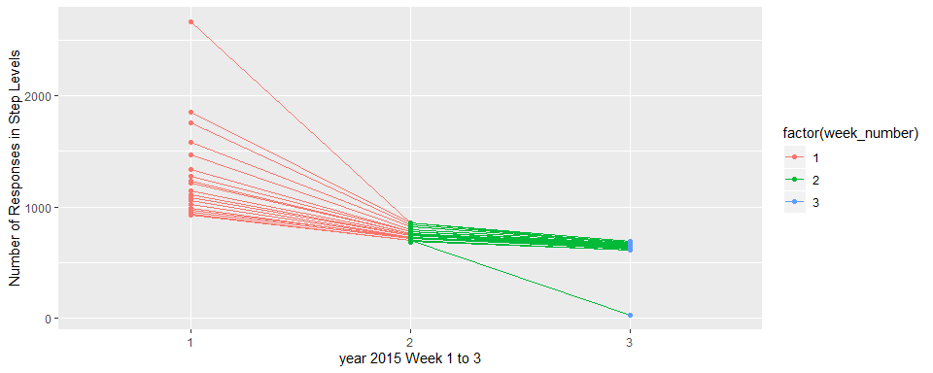

Slide 11
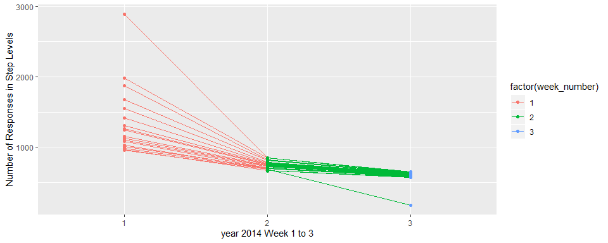

Slide 12
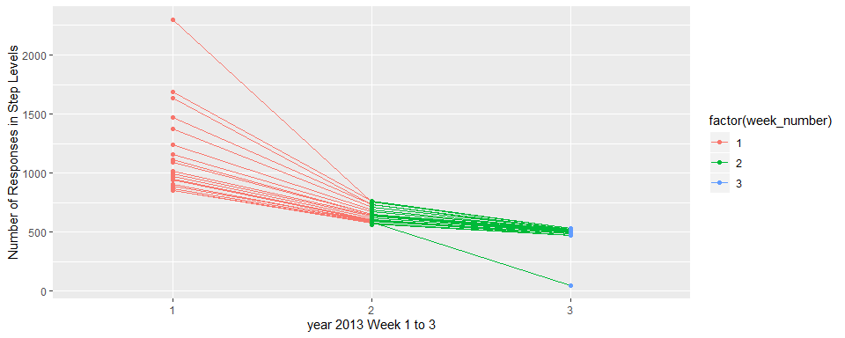

Slide 13
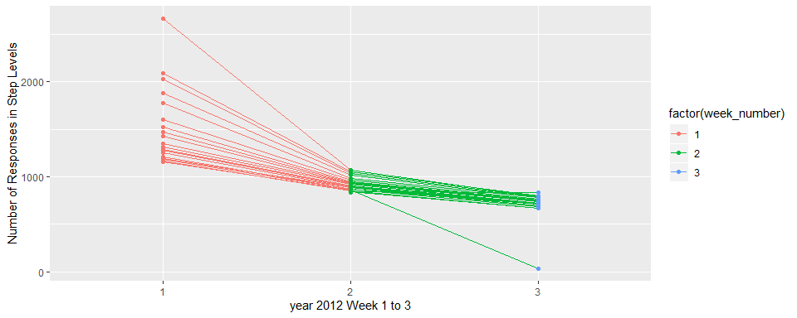

Slide 14
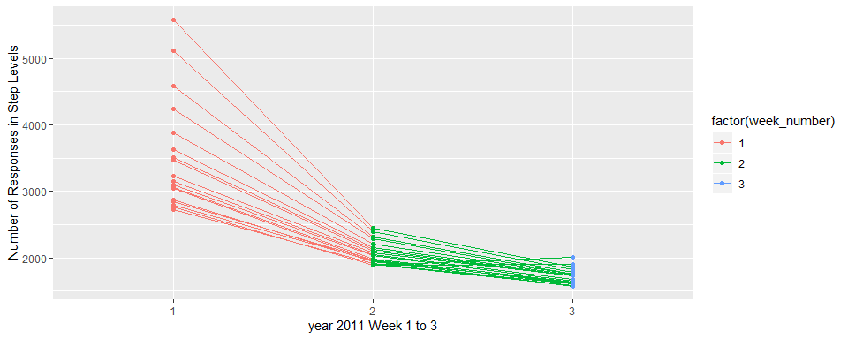

Slide 15
## year n ## 1 2011 1904 ## 2 2012 32 ## 3 2013 49 ## 4 2014 178 ## 5 2015 25 ## 6 2016 28 ## 7 2017 49

Slide 16
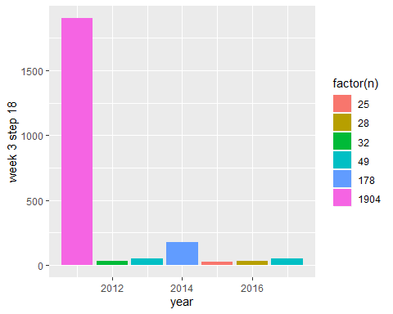

Slide 17
